Slide 1
ACR(azure container registry):
Azure container registry is nothing but we place image or to maintain the image in public cloud.
In real time we are going to create repository and we are placing the image in the repository.
If we want to send the image from onprime to public cloud we have to install AZ CLI.
We need to provide access to the AKS subnet because to pick up the image and to deploy the service.

Slide 2
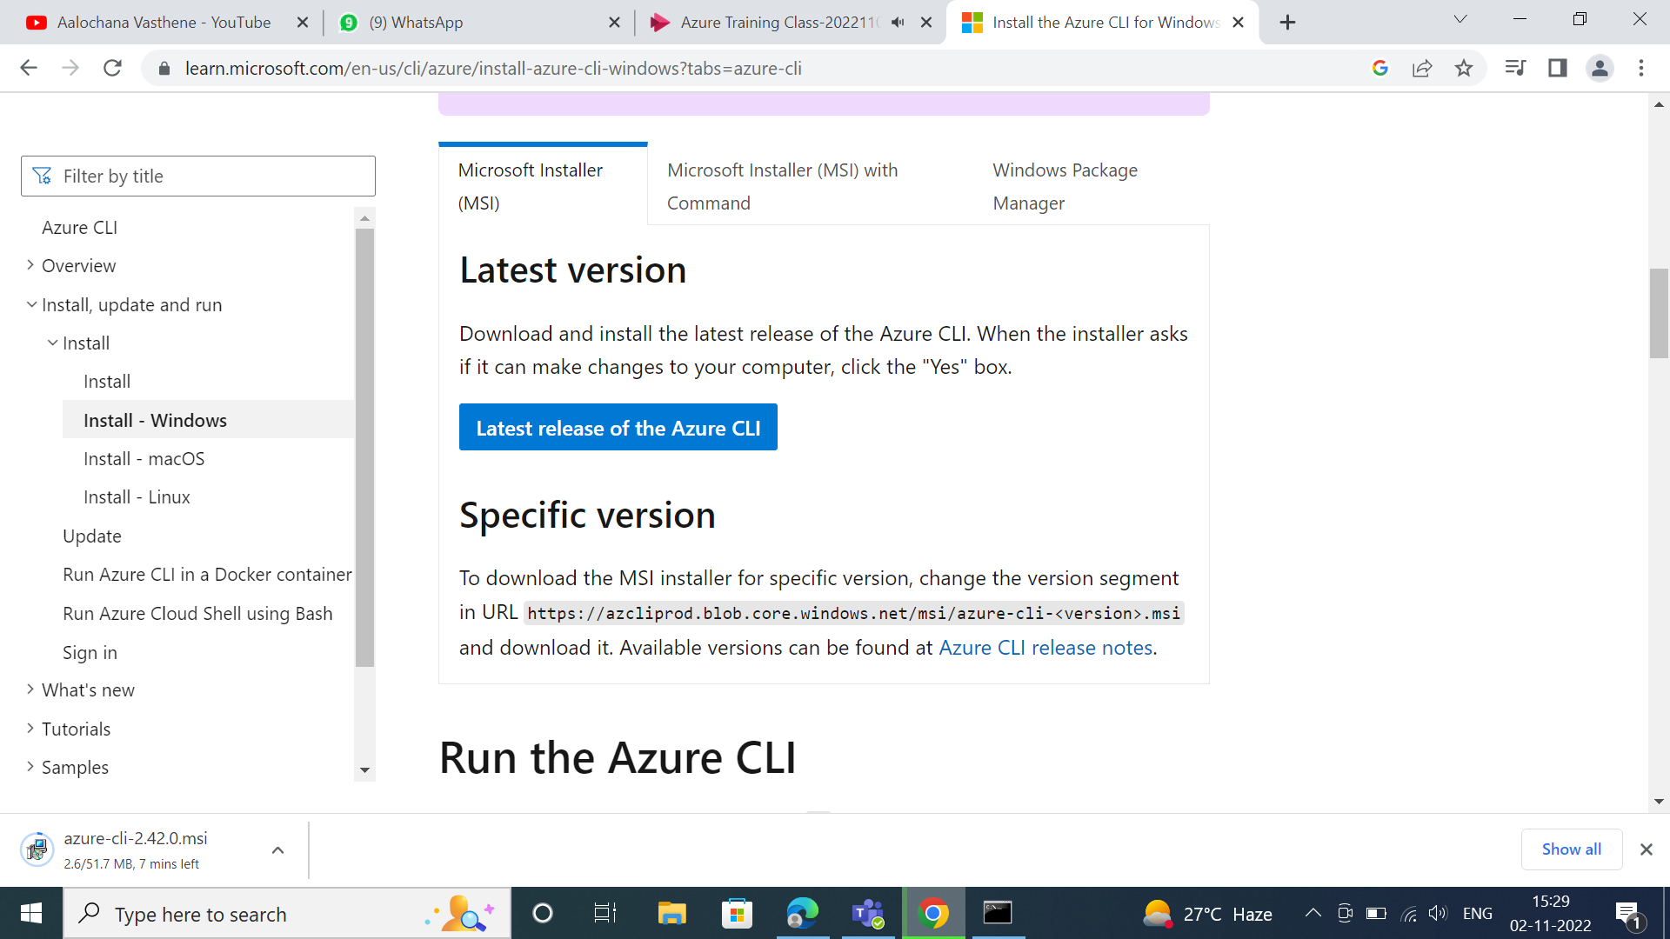
From google we can install the Azure CLI,

Slide 3
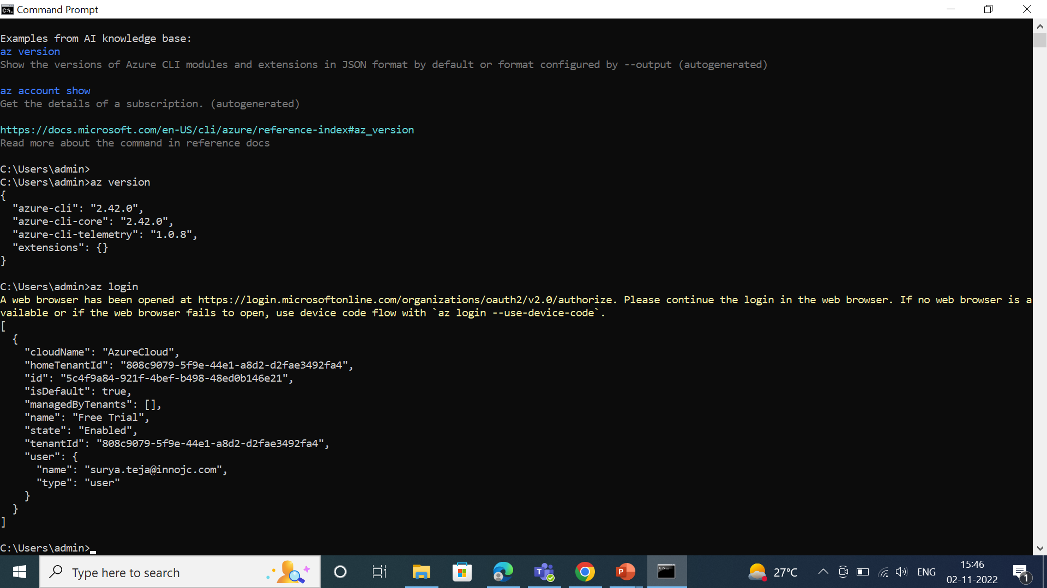
After installing the azure cli we have to verify,

Slide 4
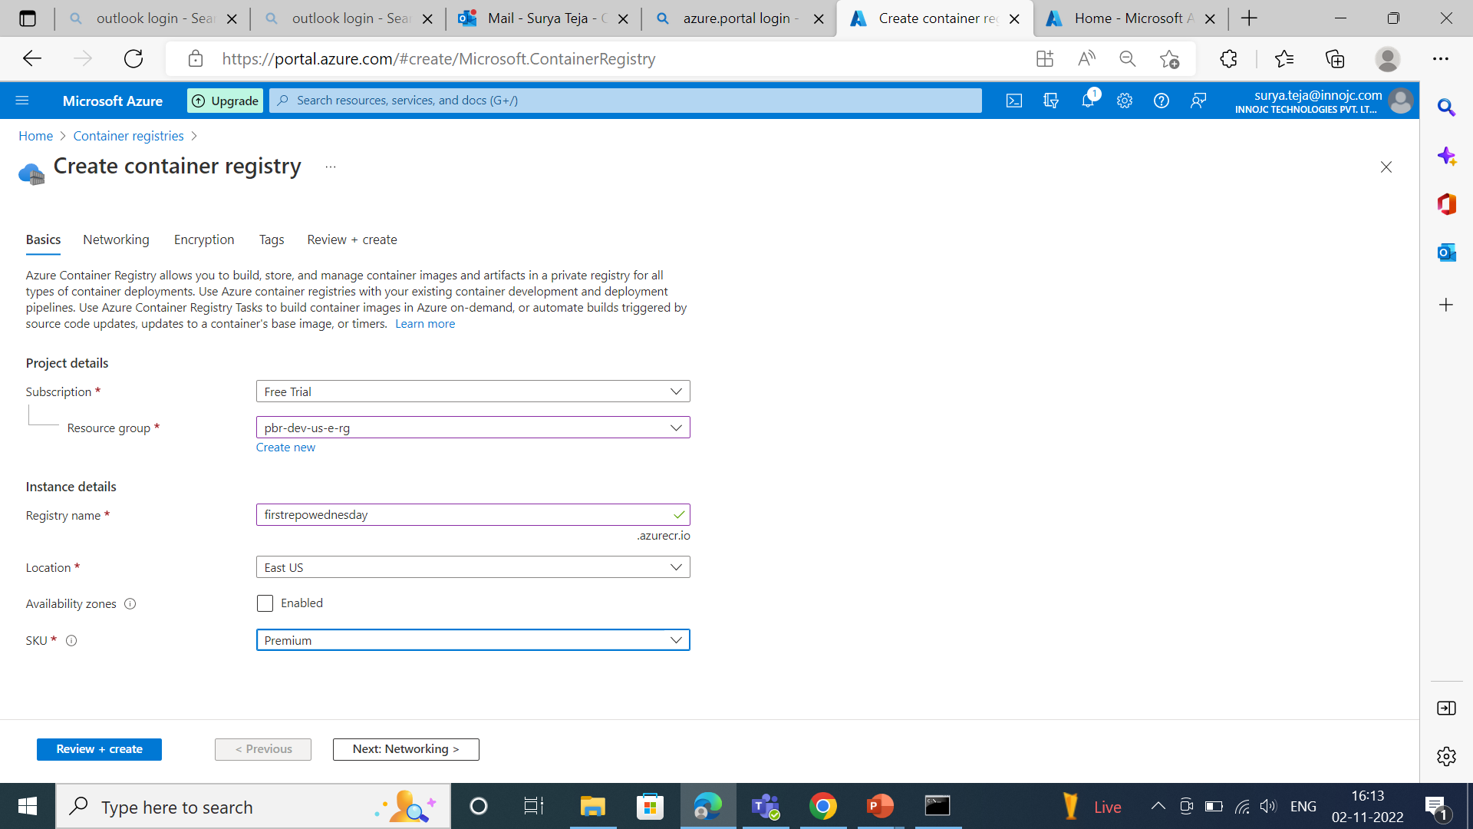
We are creating the azure container registry,

Slide 5
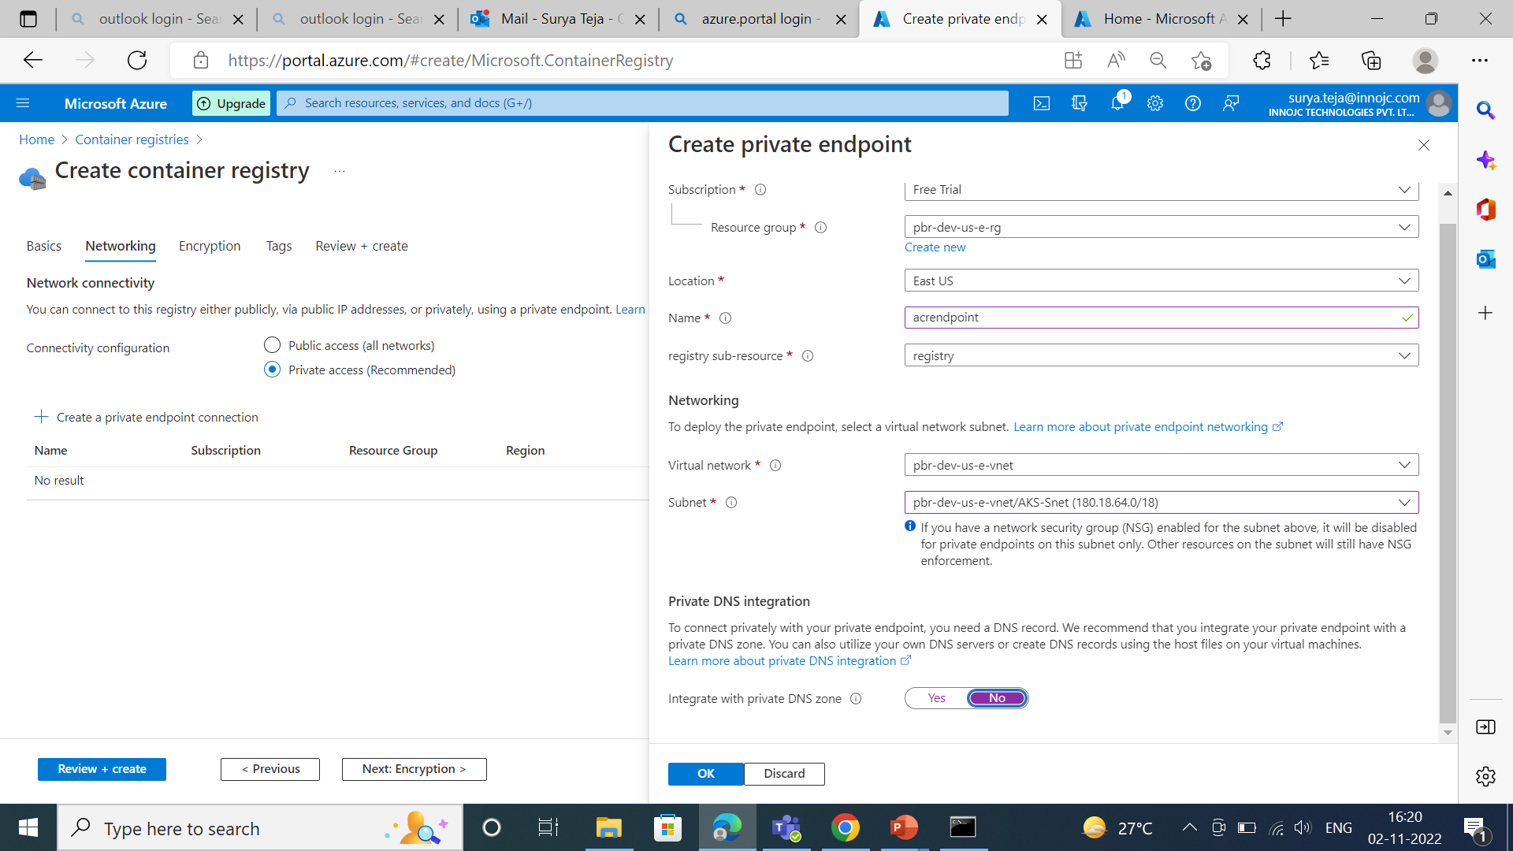

Slide 6
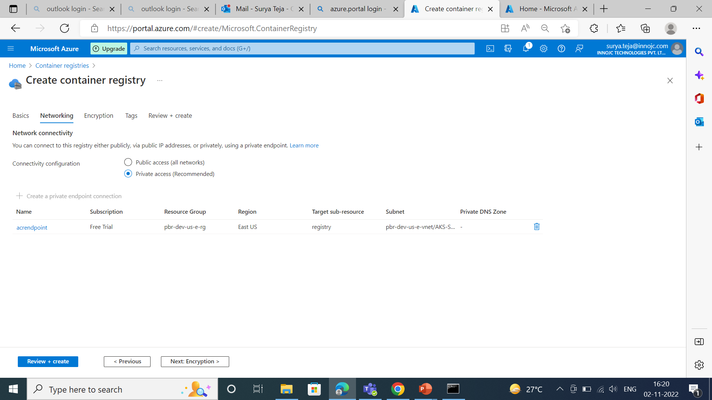

Slide 7
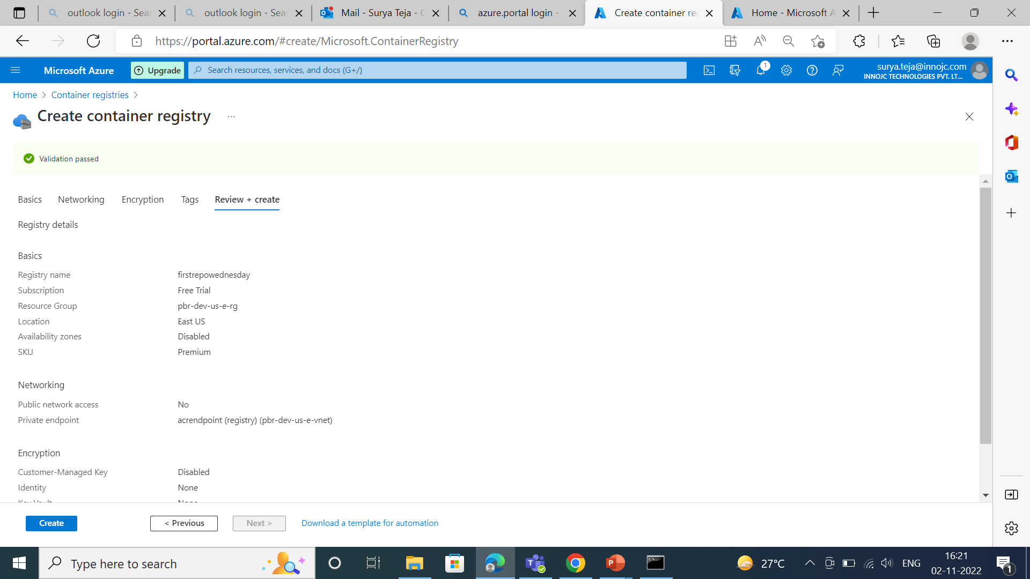

Slide 8
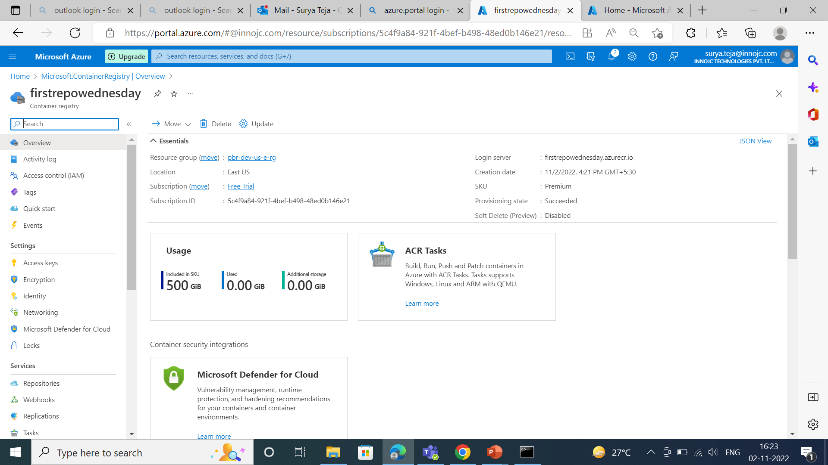

Slide 9
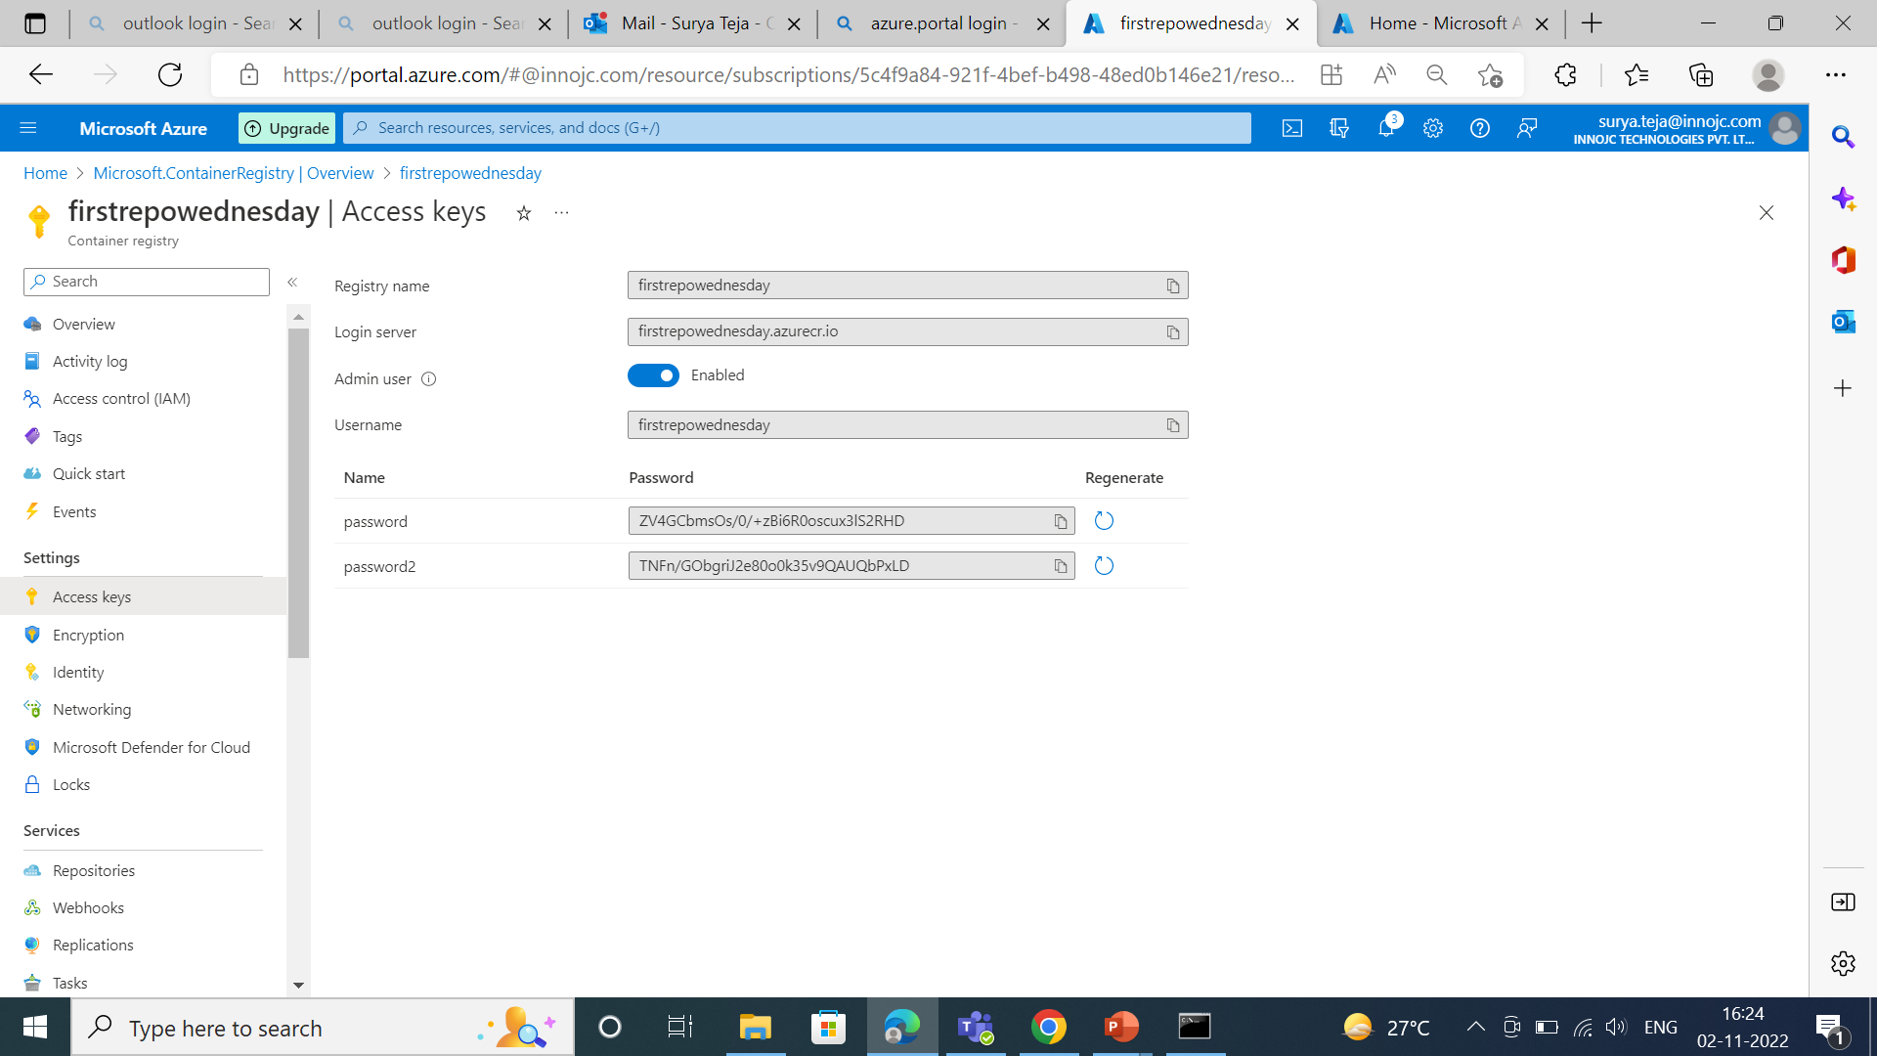
We have to enable the admin user then we will get te user name and password then we have to provide it to developer team we should not rearrange the password because we may fase the problem in pipeline.

